Slide 1

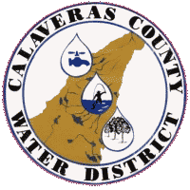
Engineering Committee Calaveras County Water District
Update
Wildfire hardening of Critical Pumps
Hazard Mitigation Grant
Big Trees 1 & 4 Pump Stations
September 9, 2025
Senior Civil Engineer
Alex Brown, PE

Slide 2
Engineering Committee September 9, 2025 Calaveras County Water District Agenda Item XX
A Notice of Interest (NOI) was filed with the California Office of Emergency Services
This action was approved by the Engineering Committee on July 8, 2025
CalOES notified CCWD that the Mazard Mitigation Grants would only be used for shovel ready projects.
The original project area included Sheep Ranch, Big Trees Village, and Timber Trails.
Only the Big Trees Village portion had a project is shovel ready.
The NOI was refiled to reflect this change and accepted by CalOES
Grant subapplication Filing Date 9/15/2025

Slide 3
Engineering Committee September 9, 2025 Calaveras County Water District Agenda Item XX
Wildfire Hardening of Critical Pump Stations
Big Trees Pump Stations 1 & 4
Serves the Big Trees Village service area
Project includes for both pump stations
Fire resistant masonry buildings to house equipment
electrical & mechanical equipment
Pumping equipment, and,
Supervisory Control and Data Acquisition system
Services 1944 connections with
potable water and resilience of fire flows
Grant Portions Complete
Notice of Intent
Benefit Cost Analysis
BCA Narrative
Cost Estimate
CE Narrative
Sub application

Slide 4
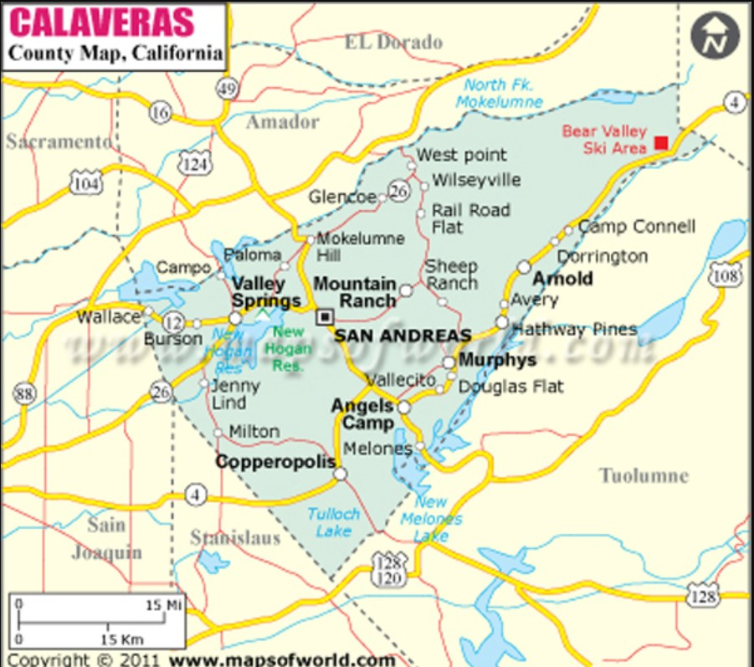
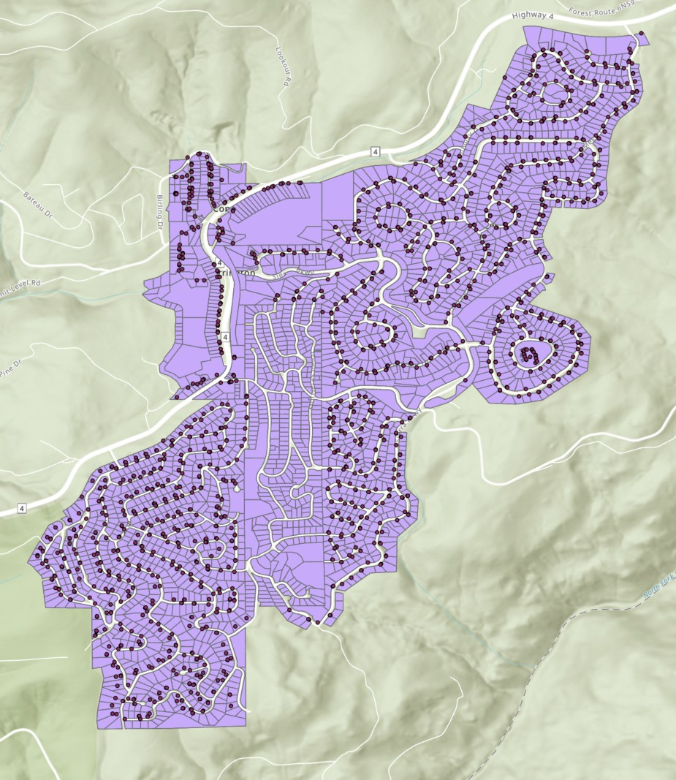
Engineering Committee September 9, 2025 Calaveras County Water District Agenda Item XX
Project Area
Big Trees Pump Station 1
Big Trees Pump Station 4

Slide 5
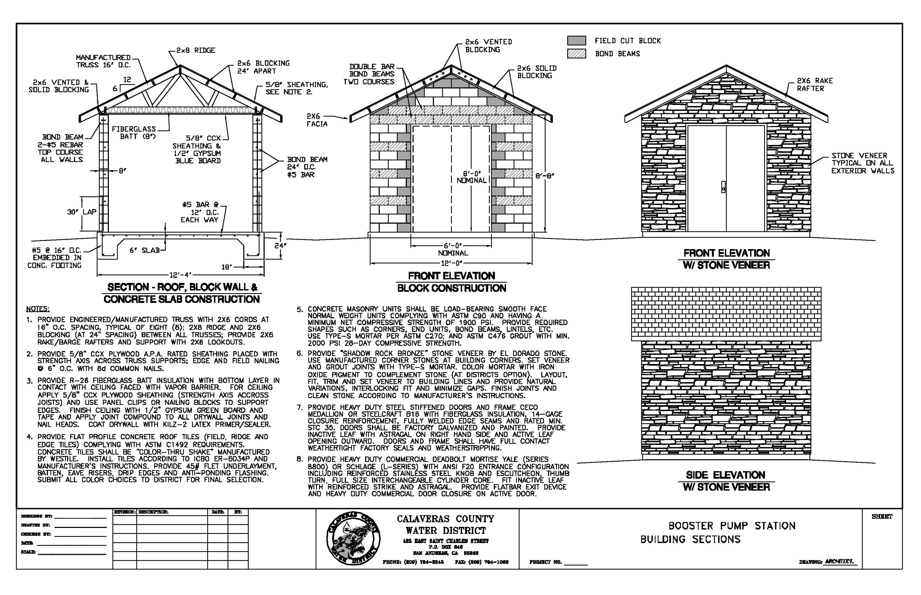
Engineering Committee September 9, 2025 Calaveras County Water District Agenda Item XX
Typical Fire Resistant
Pump Station
Equipment Building
TYPICAL BOOSTER PUMP STATION
BUILDING SECTIONS

Slide 6
Engineering Committee September 9, 2025 Calaveras County Water District Agenda Item XX
Wildfire Hardening of Critical Pump Stations
Financial Considerations
Original Estimate
Total project cost is $14,000,000
Federal share 75.0% ($10,500,00)
CCWD share 25.0% ($3,500,000)
Source of CCWD share:
Water Fund or Rate Revenue
New Estimate
Total project cost is $3,745,395.42
Federal share 75.0% ($2,809,046.56)
CCWD share 25.0% ($936,348.85)
Source of CCWD share:
Water Fund or Rate Revenue

