Slide 1
CONSTRUCTION
LOOKBACK

Slide 2
West Point
Wilseyville
Jenny Lind
La Contenta
Wallace
Southworth
Ebbetts Pass
Sheep Ranch
Vallecito
Douglas Flat
Indian Rock
Six Mile Village
Copper Cove

Slide 3
Take a look back over the years of the Calaveras County Water Districts Capital Improvement Program and Construction Projects. Through meticulous planning, strong financial support, and innovative strategies, this program ensures the reliable delivery of safe drinking water and efficient wastewater treatment.

Slide 4
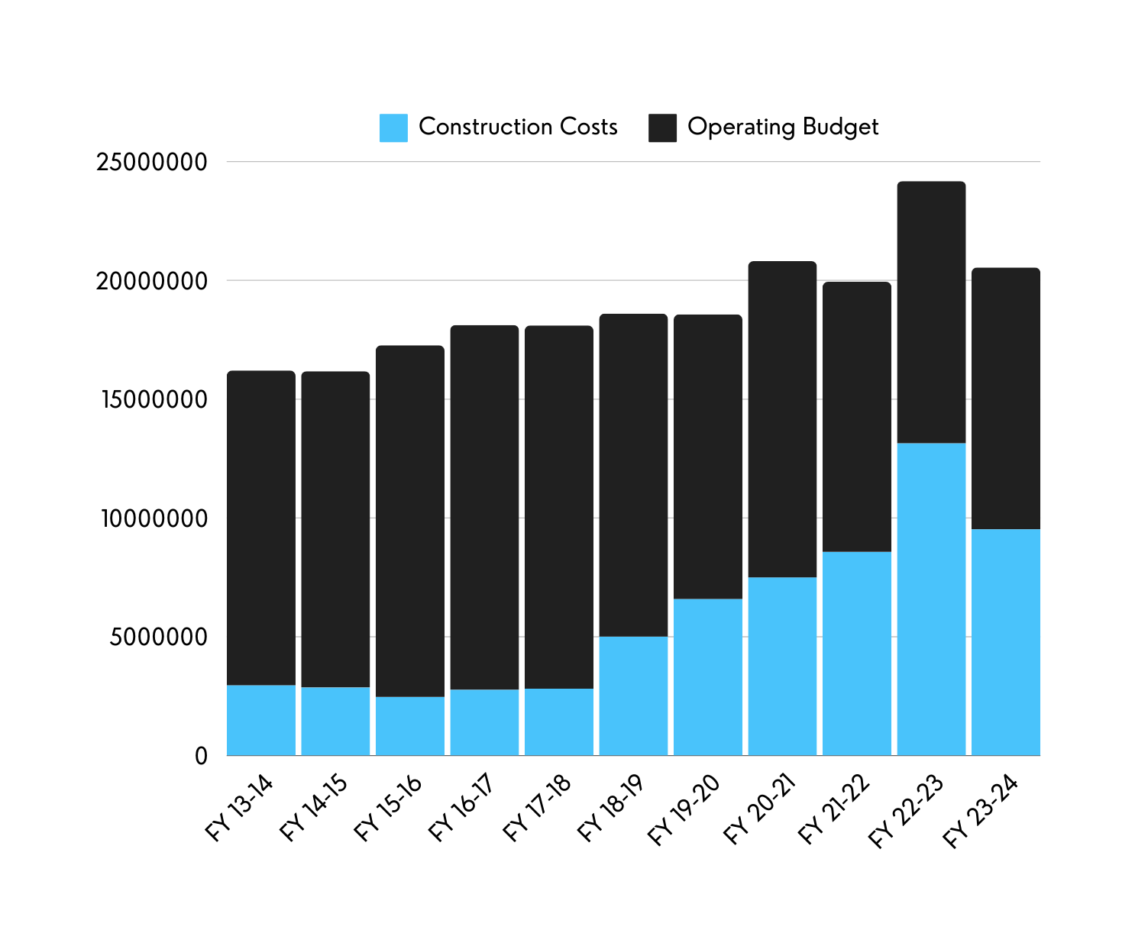
FY 13/14 - FY 23/24
$
,
,
YTD
$
,
,
Construction Costs
vs.
Operating Budget
$
,
,
$
,
,
$
,
,

Slide 5
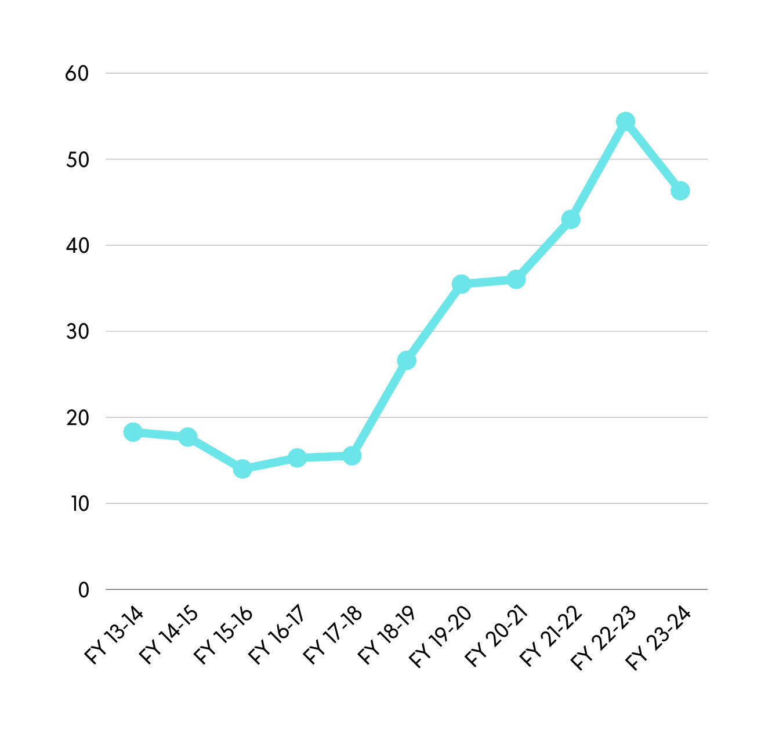
54.4%
FY 13/14 - FY 23/24
43%
46.3%
YTD
35.5%
Construction
Percentage
of
Budget
36%
26.9%
17.7%
15.3%
18.3%
14.3%
15.5%

Slide 6
FY 13/14 - FY 23/24
Totals YTD
Construction Expenditures
$61,258,051
32%
Of
Operating Budget

Slide 7
Water Projects
2010 - Current
West Point
West Point Clearwell
WP Downtown Distribution System
Master Plan Updates - WP
WP Water System Prop 84 Rehab
WP Water System USDA Rehab
WP Pipeline Leak Repair
West Point Backup Water Filter
WP SCADA Improvements
West Point Water Supply Drought Resiliency
Copper Cove
Jenny Lind
Lake Tulloch Raw Water Pump Renovation
Bow Drive Waterline Replacement
CC B-Tank Pump Station Design
CC Tank B Rehab
Master Plans Update - Copper Cove
Tank Management-CC Clearwell/Tank B
Lake Tulloch Drought Emergency
Lake Tulloch Submerged Water Line Cross
Reeds Turnpike Pump Station Replacement
Copper Cove Tank B Pump Station Renovation
CC SCADA Improvements
CC Zone B-C Trans Pipeline & Pump Station
CC O’Byrne’s Water Line Extension
CC Ozone Unit Replacement
Master Plan Update - Jenny Lind
JL WTP Flood Protection
Clearwell #2 / Repair & Paint
Wallace Tanks / Repair & Paint
Jenny Lind Tank A-B Transmission Line
Jenny Lind Pre-Treatment
Vista Del Lago/SR 26 Pipe Relocation
JL Pressure Regulating Station
Wallace SCADA System Improvements
JL Filters 3/4/5 Rehab/Coating
JL Filter 1&2 Rehab

Slide 8
Water Projects
2010 - Current
Ebbetts Pass
EP Redwood Tanks Replacement
EP WTP Filter Rehab/Painting
Meadowmont P/S Improvement
Hunter's Raw Water Pumps Renovation
Big Trees Pump Stations 1, 4 & 5 Replacement
White Pines Tule Removal/Spillway
White Pines Dam/Blanket Drain Rehab
Avery Pumps/Motor Control Soft Starts
Sheep Ranch Water Plant Replacement
Sheep Ranch Distribution System Replacement
EP/Reach 1 Transmission Main Replacement
Master Plans Update - Ebbetts Pass
EP Big Trees Redwood Tank Replacement
EP Reach 3A Trans Pipe
Larkspur Tank / Repair & Paint
EP Techite Water Line Replacement
EP Reach 1 Water Line Replacement
Fly In Acres Assessment District Construction
Blagen Mill Pond Restoration
Other Projects
AMR/AMI Meter Program
Slurry Line Improvements
West County GW Monitoring
Pipeline Replacement Program
SNC Regional Hwy 4 Study
CCWD Operations Headquarters
Capital R&R-General
Wilson Dam
District Corp Yard
Turbidimeter/Analyzer Replacement

Slide 9
Sewer Projects
2010 - Current
Vallecito
Arnold
WWTP Improvements
Secondary Clarifier
Leach Field Improvements
Vallecito WWTP Expansion
Vallecito WWTP Permit and Monitoring
Vallecito WWTP Monitoring Well Installation
Vallecito WWTP Storage Expansion
Vallecito I&I/Equalization Improvements
Indian Rock East Sand Filter Rehab
Vallecito/DF Headworks Screen
Vallecito WWTP System Improvements
Forest Meadows
FM WWTP Phase 1 Improvements
FM UV Disinfection System Replacement
West Point / Wilseyville
WP/Wilseyville Sewer Service Area Plan Study
West Point/Wilseyville Consolidation

Slide 10
La Contenta / Jenny Lind / Wallace
Wallace Improvement Projects
LC WWTP Discharge Permit
Jenny Lind Capacity Plan Update
La Contenta Wastewater Master Plan
LC Huckleberry LS (Pre-design)
Wallace Treatment Plant Renovations
Huckleberry L/S Rehab/Expansion
LC Biolac, Clarifier & UV Improvements
La Contenta Spray Fields
La Contenta Sand Filter Rehab
Jenny Lind Force Main
Copper Cove
CC WWTP Expansion to 0.5mgd, Phase 1
CCS Pond 6 Expansion
CC Lift Station #22
CC WW Reclaim Permit Project
Poker Flat L/S 8, 12 & 13 Force Main
CC L/S 22 Replacement
Poker Flat L/S 9, 10 & 11 Replacement
CC L/S 15 & 18-Electrical Upgrades
Copper Cove Pond 6
Copper Cove Wastewater Master Plan
Eagle Pt LS CC LS #11 Replace
Millie Ct LS CC LS #9 Replace
Poker Flat Rd LS CC LS #10 Replace
CC Secondary Filter
CC Tertiary/UV Improvements
Other
Projects
Pipeline Replacement Program
Capital R&R-General
Lift Station Renovations
Southworth Collection System/I&I Mitigation
Capital Non-CIP Projects
Tertiary Filter Rehab
Sludge Tank/Belt Press Improvements
Collection System Rehab and I&I Mitigation

